Slide 1
Coca Cola Stock - Live and Updated
Presented by: Ashok Nagar
Tools: Python, Pandas, Seaborn, Matplotlib

Slide 2
Problem Description
The Coca Cola Stock project aims to monitor and analyze the live performance of Coca Cola's stock. The focus is on identifying price trends, volatility, and trading volume patterns. The goal is to provide insights for potential investment decisions and understand market sentiment.

Slide 3
Insights
1. Stock prices show periodic fluctuations influenced by market conditions.
2. Trading volumes tend to spike during major market announcements or earnings reports.
3. Short-term moving averages indicate bullish or bearish momentum phases.
4. Long-term price stability reflects Coca Cola's strong brand presence and consistent demand.

Slide 4
Conclusion
The analysis of Coca Cola's live stock data highlights both stability and growth potential. Investors may consider the stock a reliable long-term holding while remaining aware of short-term market fluctuations.

Slide 5
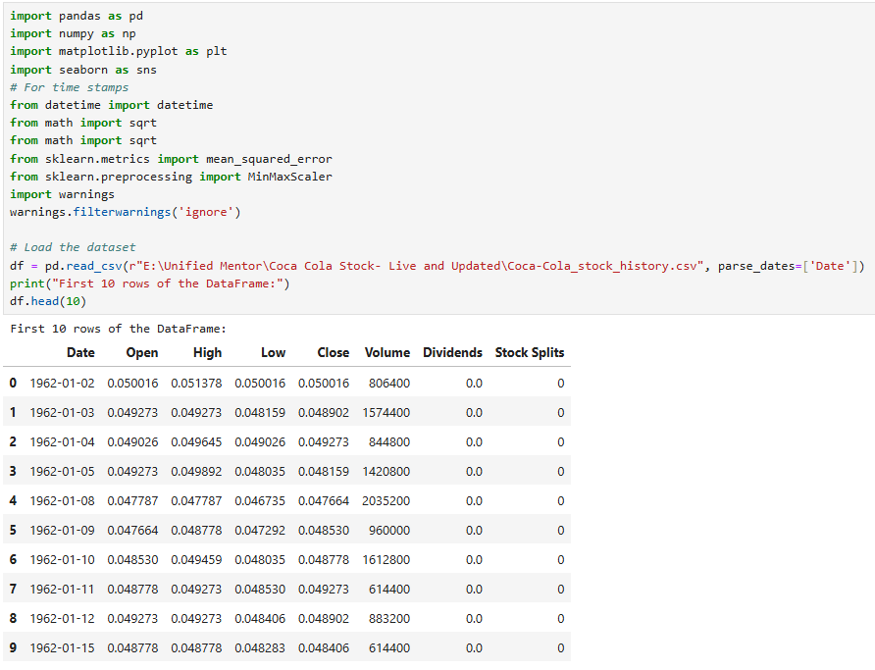
Python Code
Step 1: Import Libraries and Load Data

Slide 6
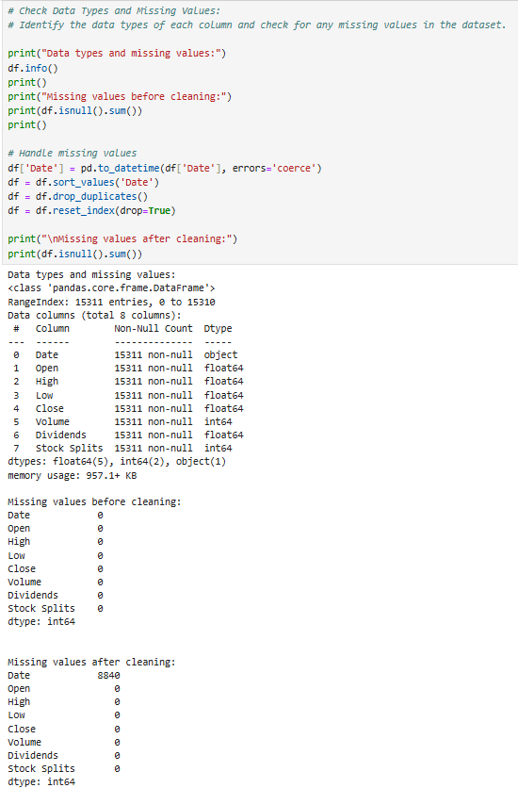
Step 2: Data Cleaning

Slide 7
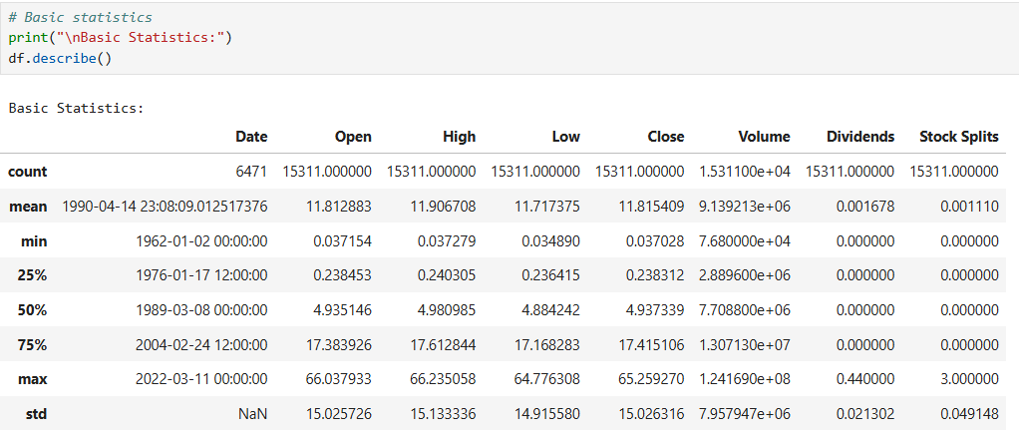
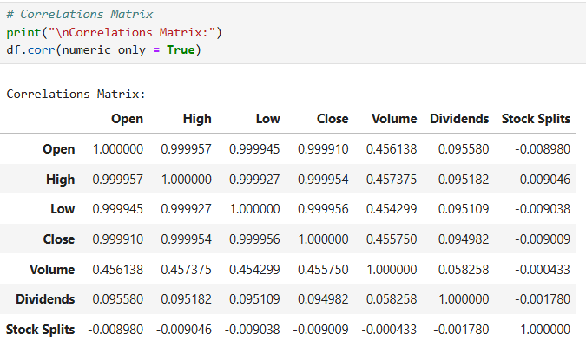
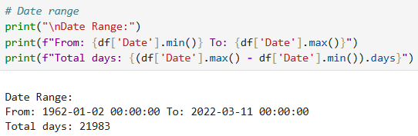
Step 3: Exploratory Data Analysis (EDA)

Slide 8
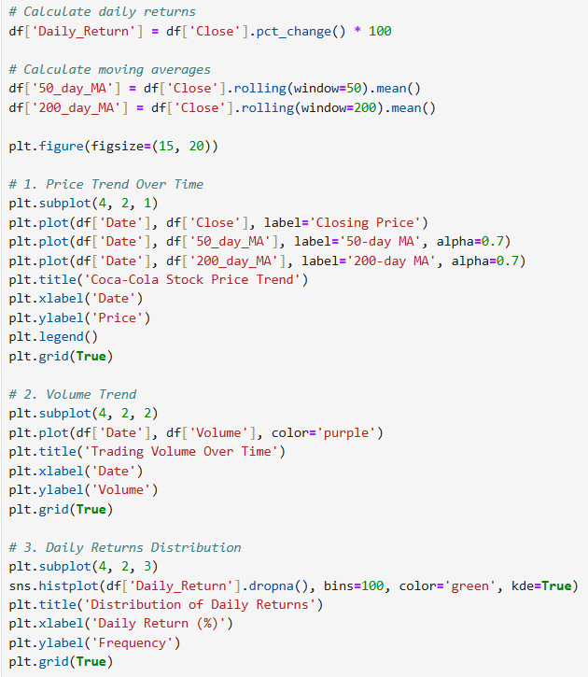
Step 4: Visualizing Key Insights

Slide 9
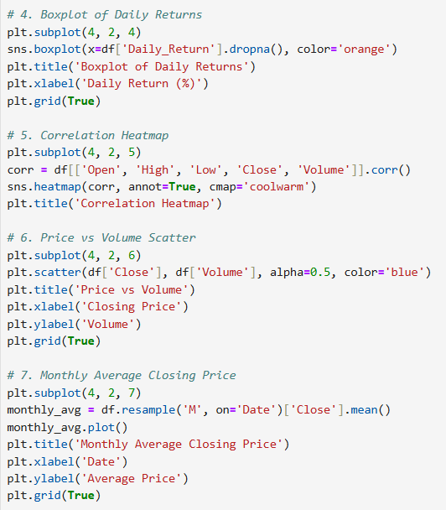

Slide 10
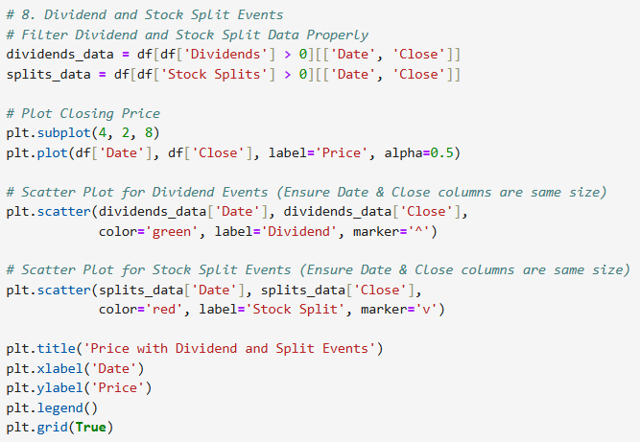

Slide 11
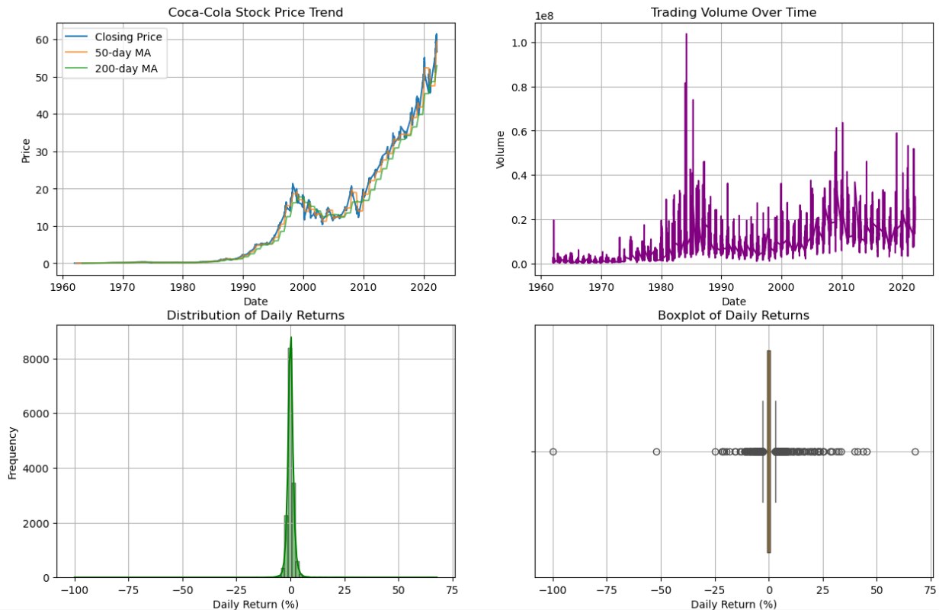

Slide 12
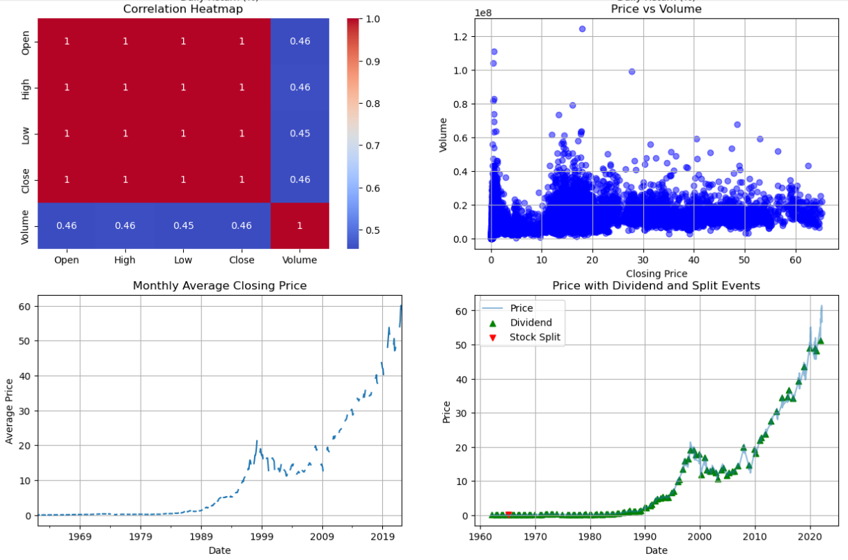

Slide 13
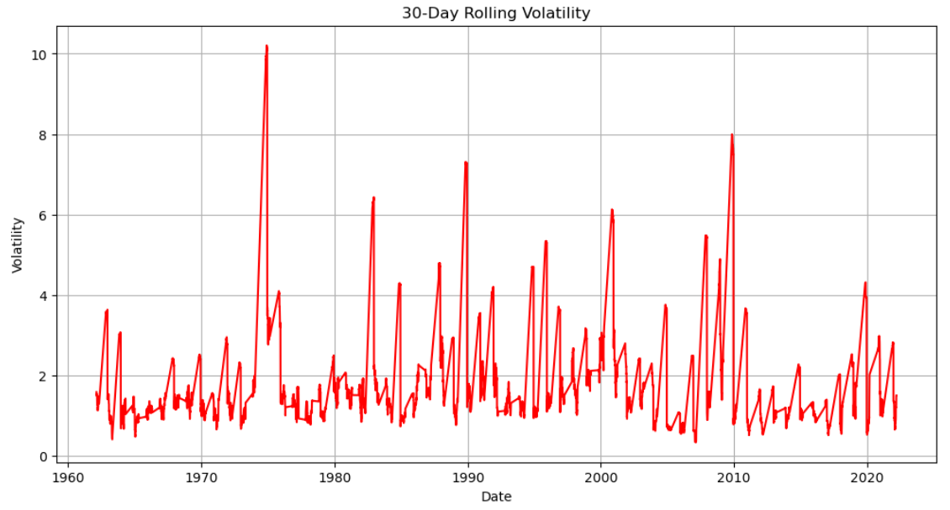

Slide 14
